Slide 1
802.11 Technology, Wi-Fi Basics
-Layered architecture, Modulation/coding overview

Slide 2
Contents
1.OSI 7-layer architecture
2.802.11 within OSI framework
3.Wi-Fi standards
4.Data link layer in action
5.Physical layer in action
6.802.11 Working group
7.Wi-Fi 2.4 GHz Channels
8.Wi-Fi 5 GHz channels
9. 802.11 Coding schemes
10. PSK & QAM Modulation
11. OFDM scheme and implementation
12. 802.11n standard and maximum data rate

Slide 3
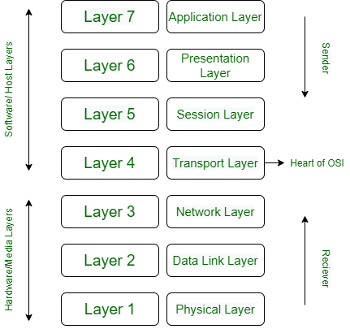

Open Systems Interconnection model (OSI) -Overview
Developed by International Standards organization in the year 1984
Basis for networking to support interoperability between different products and software.
User interaction window
Email, s/w programs
Data to common format
ASCII to EBCDIC
Translation, compression, encryption
Establish connection
& session management
authentication, authorization
data segmentation
Flow control, error control
Heart of OSI
TCP,UDP : with/without feedback
Segments encapsulated, routing packets to terminal
IP addresses on segments,
Short Path determination
Packets into Frames (Packet + MAC address of sender/Receiver
Data Frames are read & physical addresses added
Frames to bits and sent over the n/w thru a media
Data bits logically arranged, encoded before sent through a media.

Slide 4
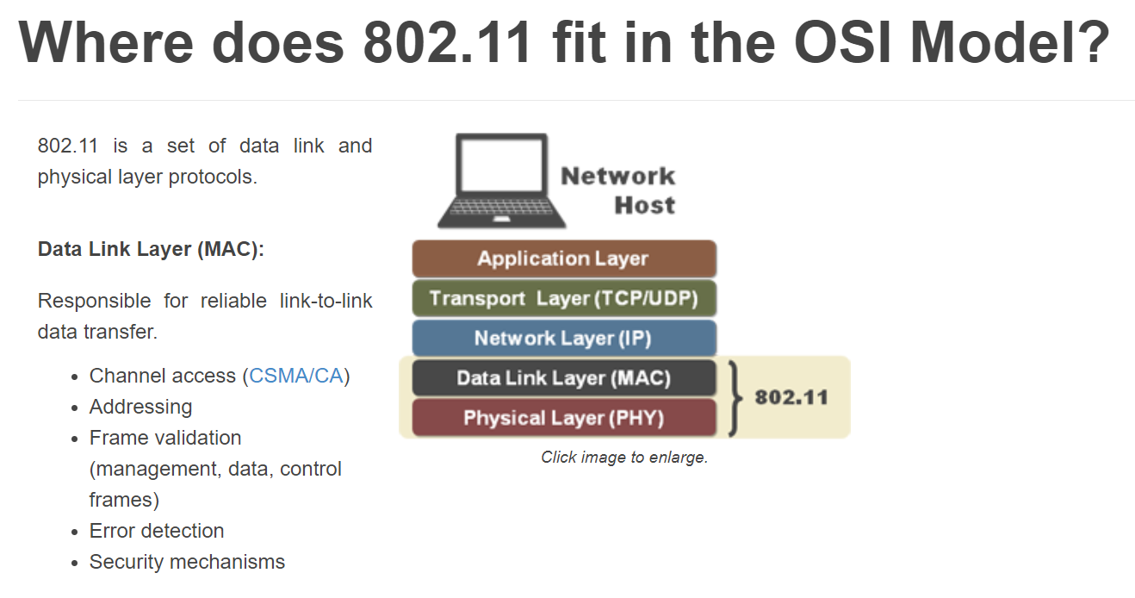
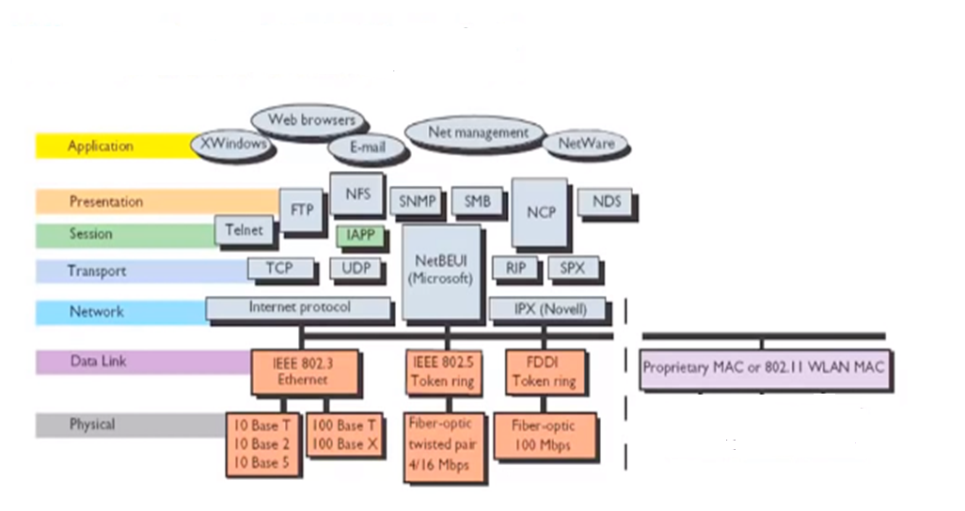
802.11 protocol within OSI framework
802.11 is a set of Data link and Physical layer protocols
Mac layer is responsible for reliable link to link data transfer (Channel access, addressing, frame validation, error detection, security mechanisms
Physical layer is responsible for dta transfer through a media (Cable/Light/Wireless
2.4GHz DSSS ,OFDM
5GHz DSSS ,OFDM
6GHz DSSS ,OFDMA

Slide 5
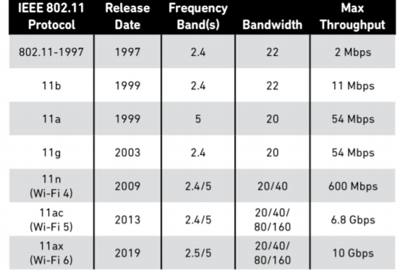
Wi Fi standards , Data link & Physical layer
Wi-Fi is a trade mark owned by Wi-Fi alliance and it is a collection of protocols that replace Ethernet cables
Data Link
Layer
Logic Link control(LLC)
Medium Access Control(MAC)
802.11
FHSS
802.11b
DSSS
802.11a
OFDM
802.11g
OFDM
802.11n
OFDM
MIMO
802.11ac
OFDM
MIMO
802.11ax
OFDMA
MUMIMO
Physical
Layer

Slide 6
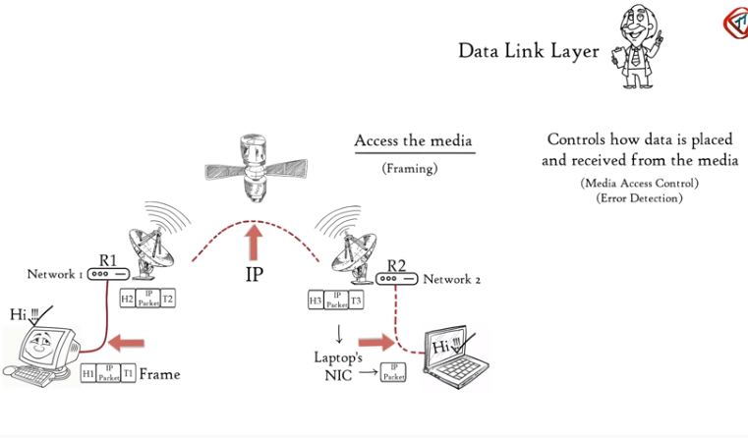
Data Link layer–Access to media and control scenario
LLC Linking upper host layers to access media (Cable/Optical/Wireless) through frames
Controls how data is placed and received from the media through Media Access Control- CSMA and Error detection ( Tail bits in the frame are for error detection)

Slide 7
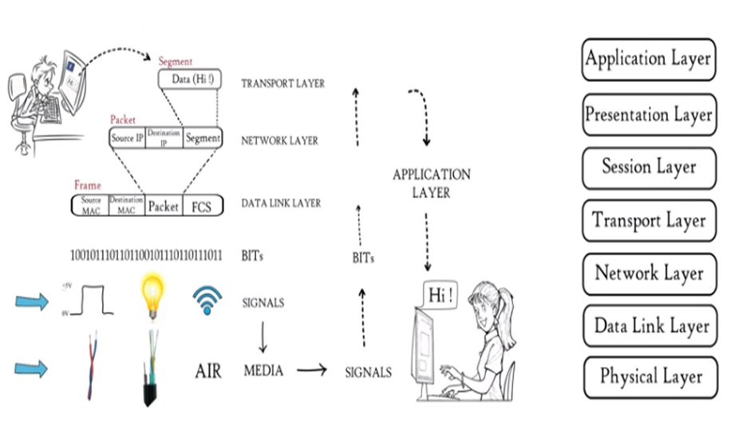
Physical layer in action – A big picture
Data frame received from DLC layer is a sequence of bits ((1’s and 0’s)
Bit sequence is converted to signal and transmit over local media (Ethernet/Fiber/Wireless)

Slide 8
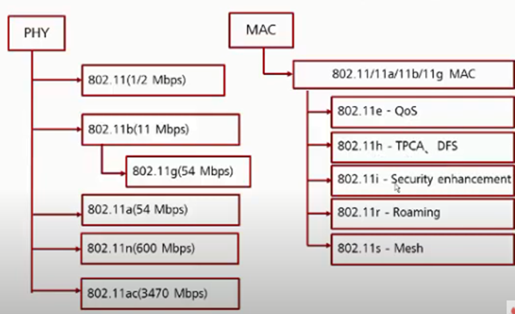
802.11 Work groups
802.11ax (9.6Gbps)

Slide 9
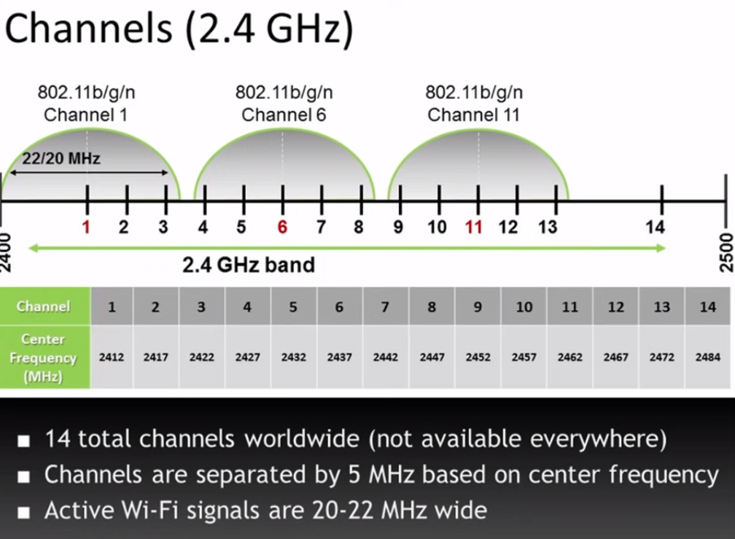
2.4GHz band Wi-Fi Channels

Slide 10
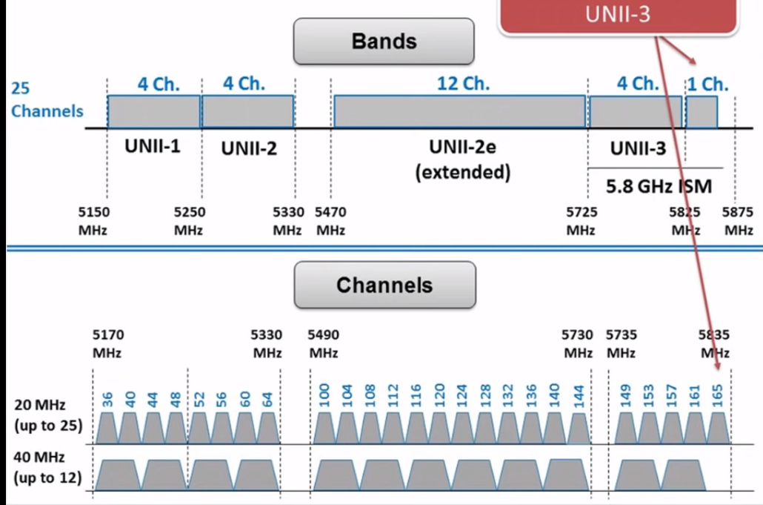
5GHz band Wi-Fi Channels

Slide 11
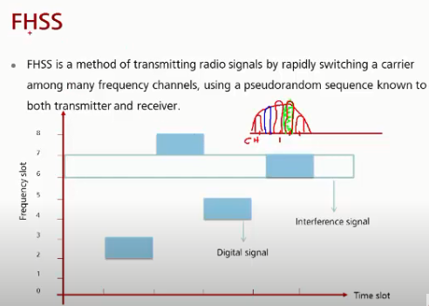
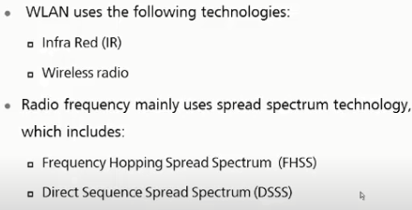
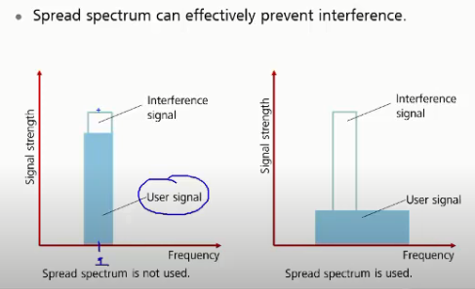
802.11 Coding schemes
802.11 (oldest standard-1997)
Spread spectrum method

Slide 12
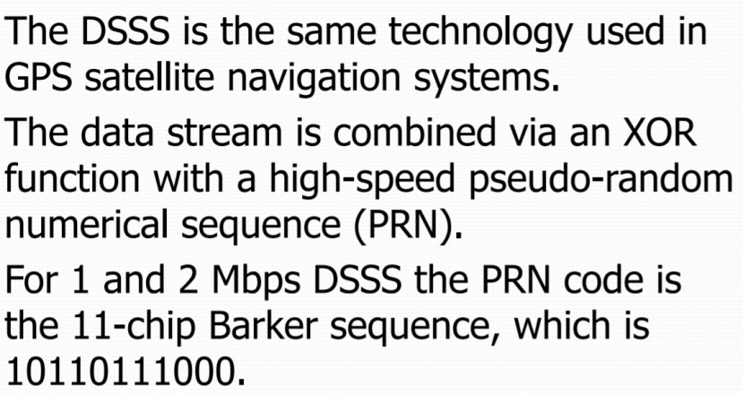
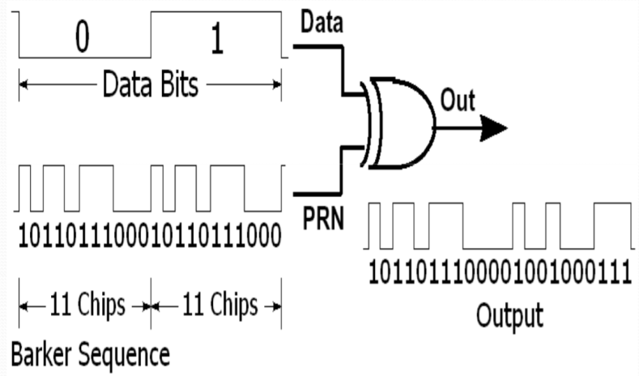
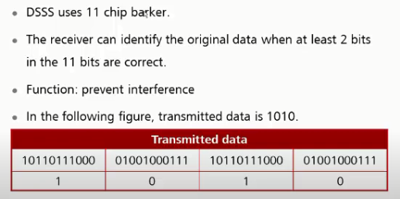
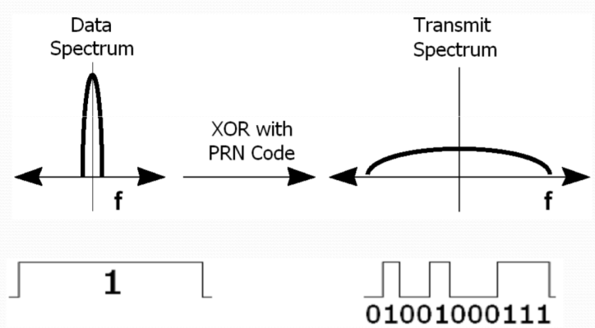
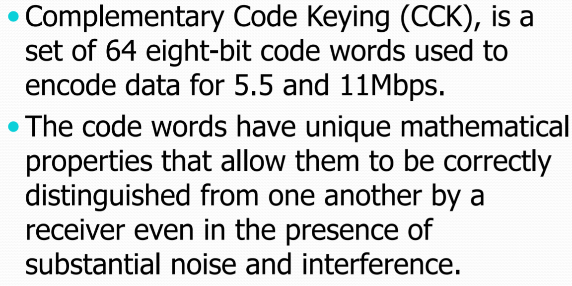
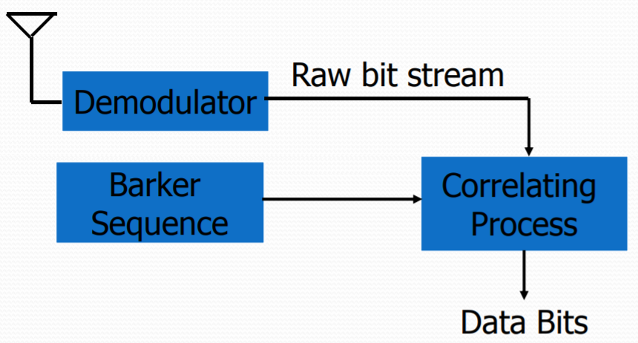
DSSS Coding Cont’d
Transmit spread spectrum
Complementary Code keying (CCK)
Rx De-spreading

Slide 13
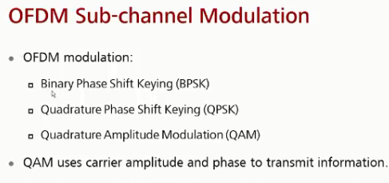
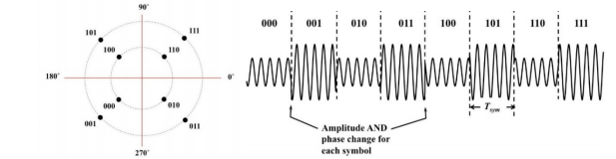
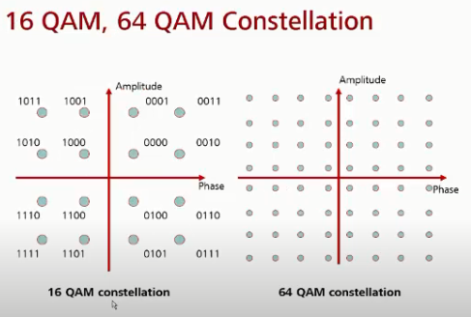
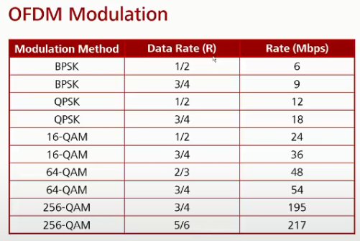
Quadrature Amplitude Modulation (QAM)
8 QAM
This system uses 4 possible phase angles and 2 possible amplitudes
Constellation shows 8 symbols along with 3 bits digital words
OFDM modulation & code rates

Slide 14
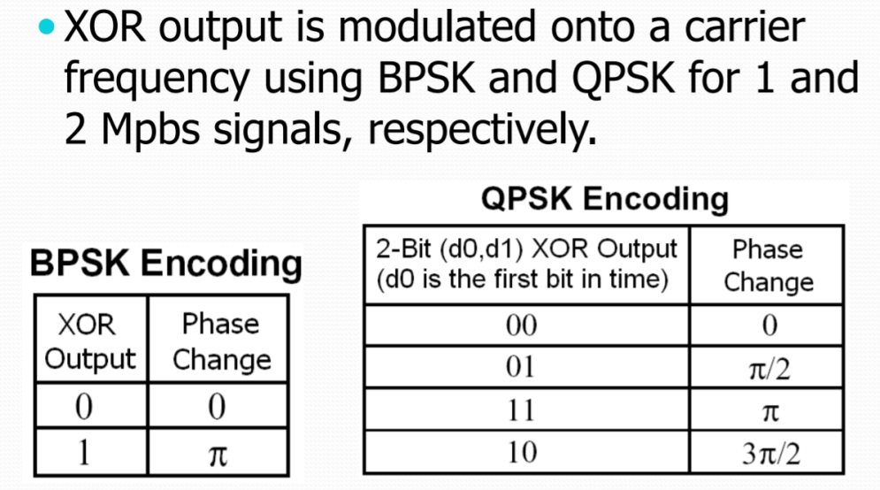
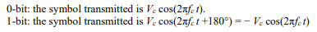
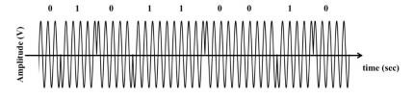
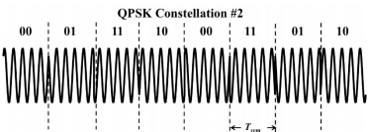
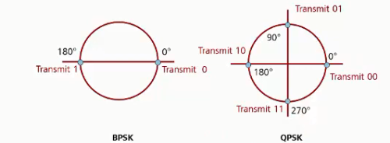
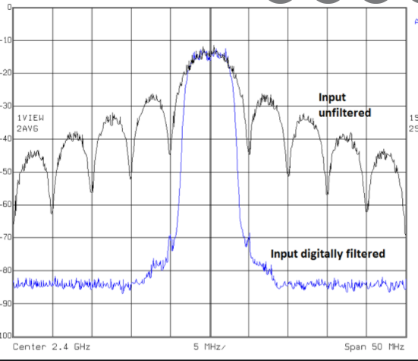
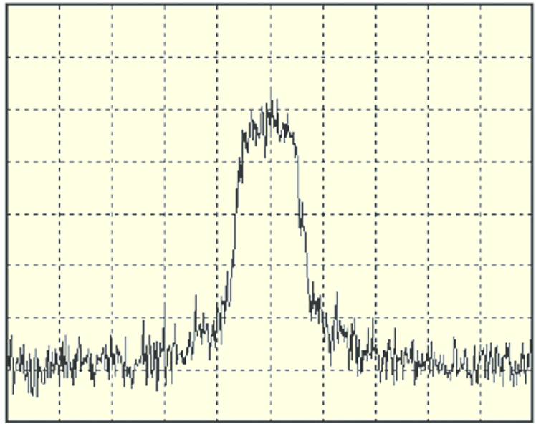
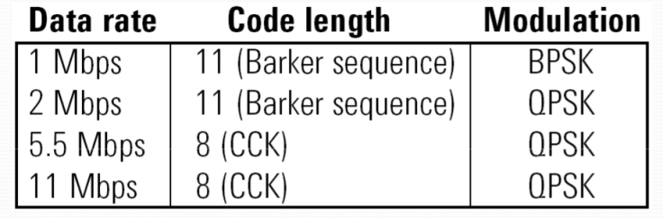
BPSK,QPSK Modulation schemes
BPSK
QPSK
BPSK Spectrum
Raised cosine pulse shape
to confine main lobe
Prefiltered Filter to
confine main lobe
QPSK Spectrum

Slide 15
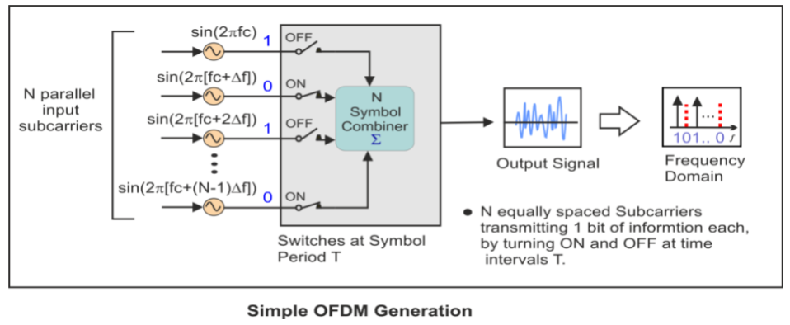
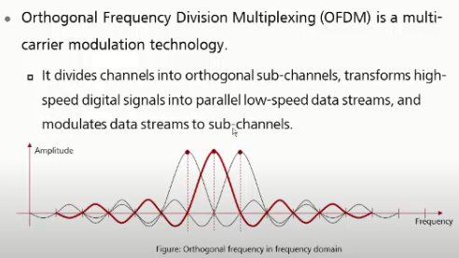
OFDM Multicarrier Scheme
Why OFDM?
High spectral efficiency :Bits/Hz
Resilient to frequency selective fading & narrow band interference
Immunity towards Multi path fading resulting in Inter Symbol Interference(ISI)
OFDM makes use of many closely spaced orthogonal subcarriers that are transmitted in parallel
Each subcarrier is modulated with a conventional digital modulation scheme (such as BPSK,QPSK, 16QAM, etc.)
combination of many subcarriers enables data rates like conventional single-carrier modulation schemes within equivalent bandwidths
Orthogonal sub carriers

Slide 16
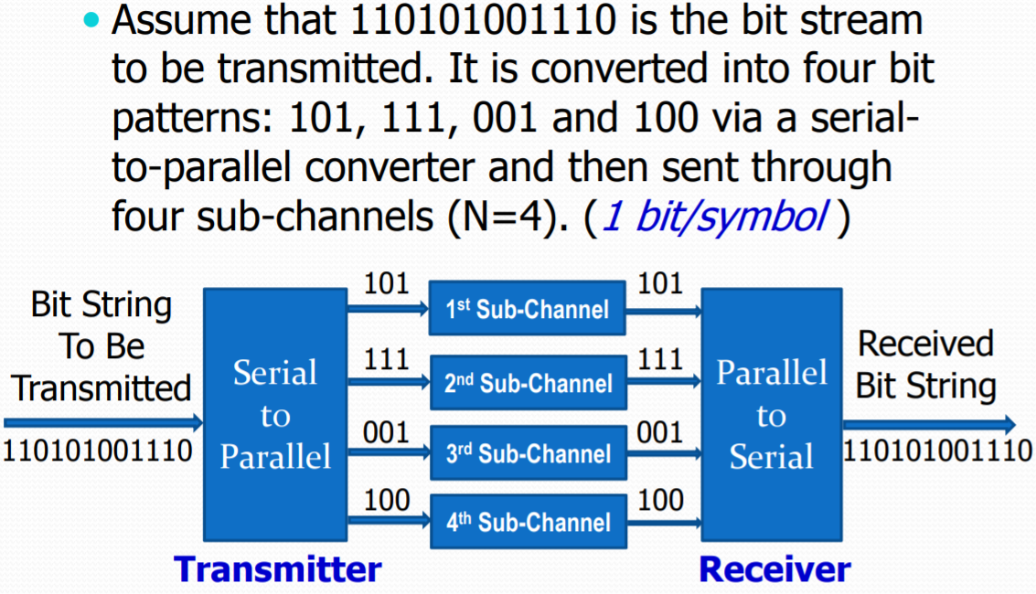
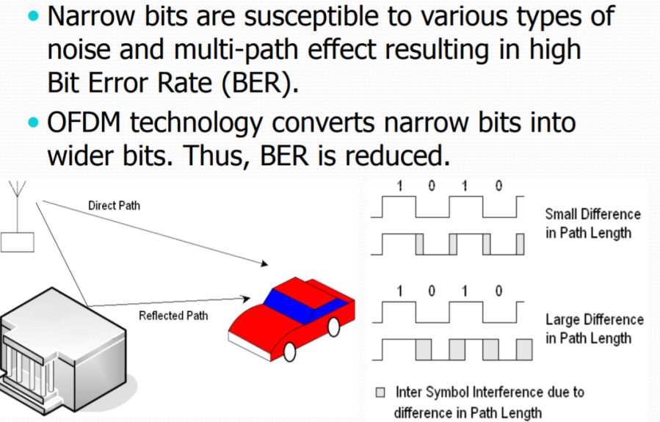
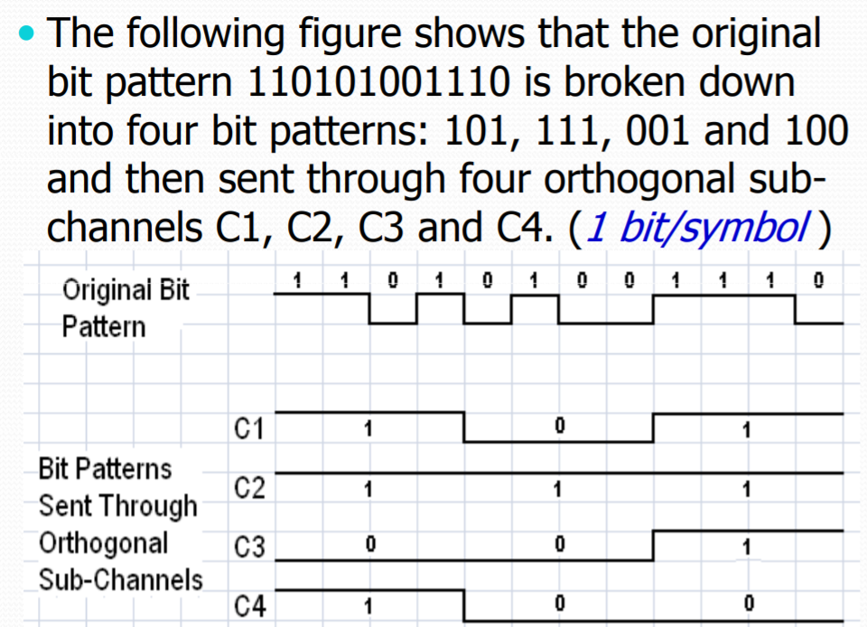
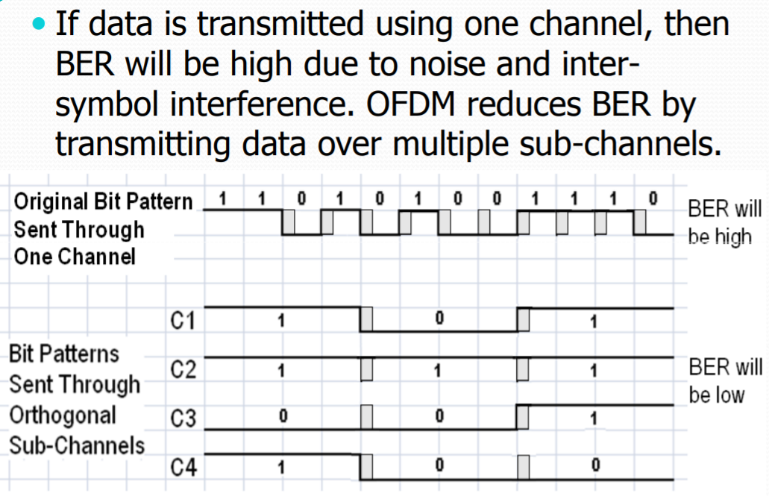
OFDM modulation format and advantages

Slide 17
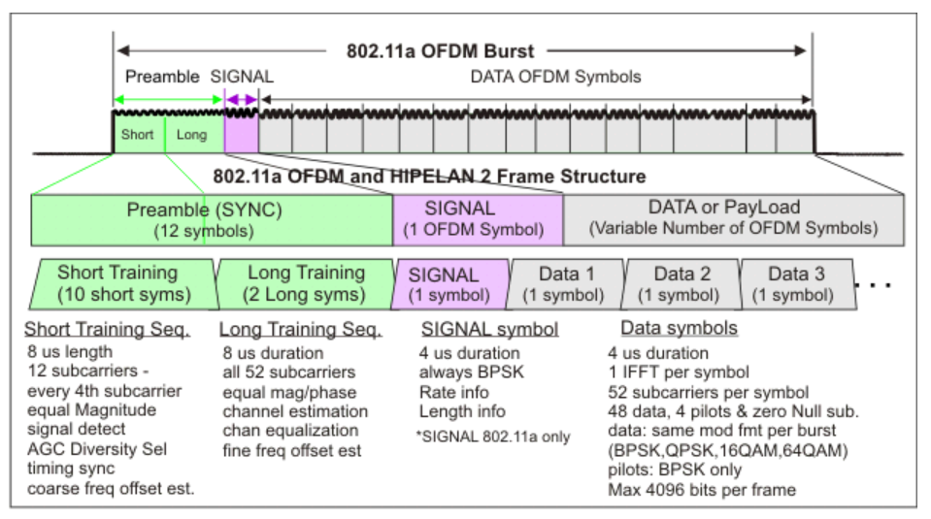
Typical OFDM burst in 802.11
The Preamble with known amplitude and phase is used for synchronization and channel equalization.
The SIGNAL field is transmitted using BPSK, and contains the length, modulation type, and data rate information.
Multiple OFDM symbols containing the input data bits are appended to complete the burst.

Slide 18
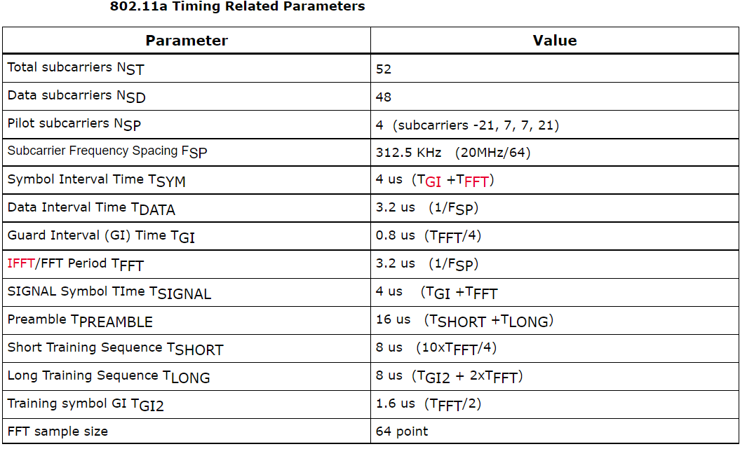
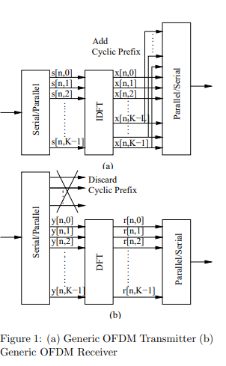
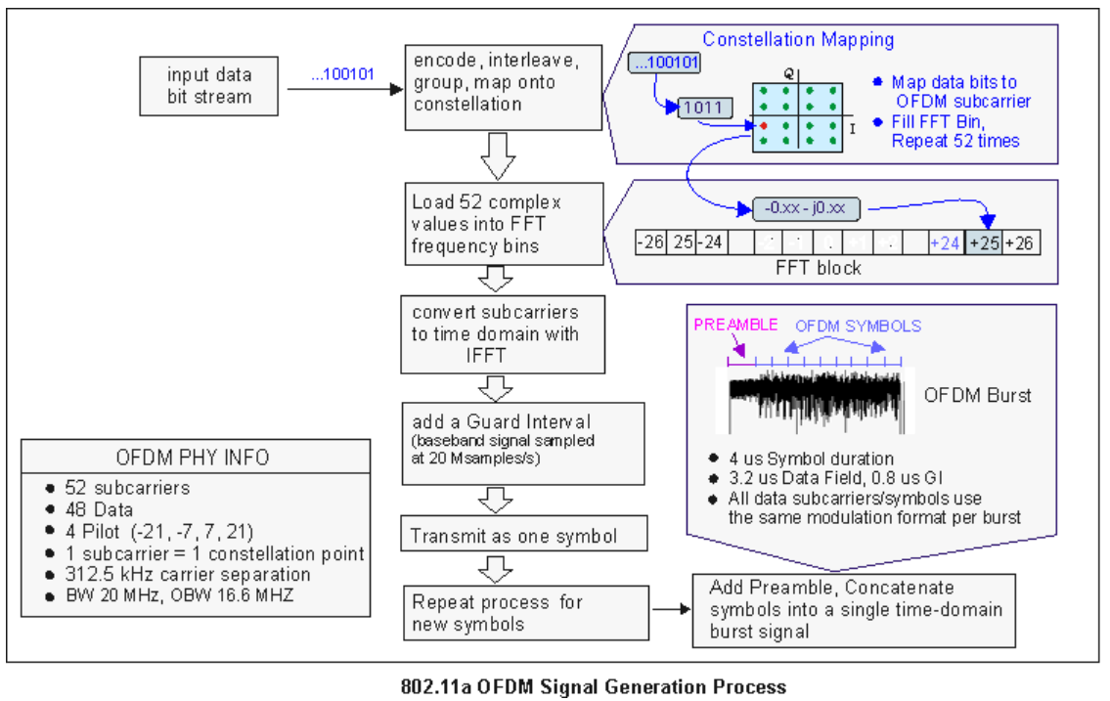
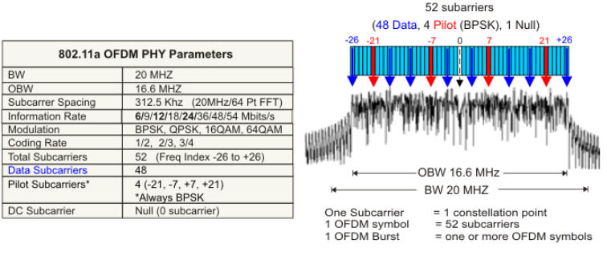
OFDM Implementation
802.11a Burst signal timing parameters
OFDM Transmitter & receiver
802.11a Burst signal spectrum
OFDM generation

Slide 19
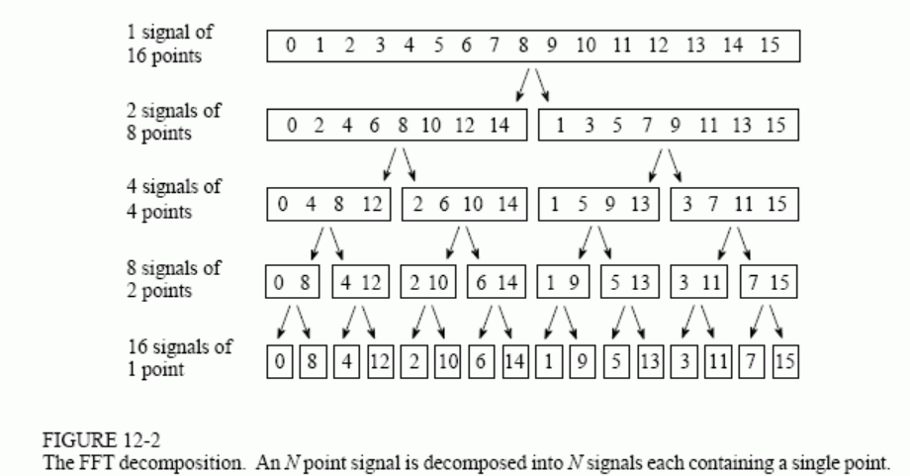
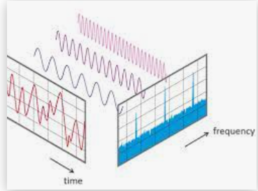
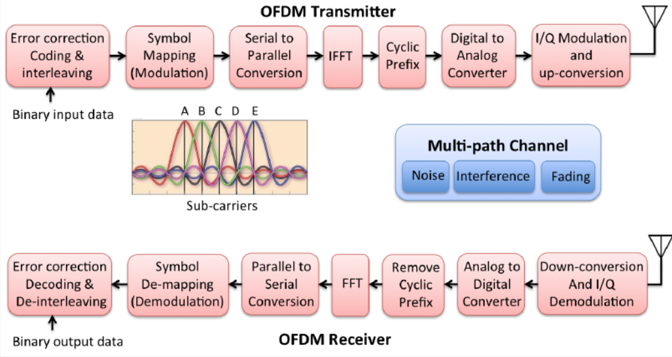
FFT ,IFFT and OFDM TX/RX
FFT decomposes a given signal
FFT Decomposes an N point time domain signal into N time domain signals each composed of a single point.
Calculate the N frequency spectra corresponding to these N time domain signals. Lastly, the N spectra are synthesized into a single frequency spectrum.
OFDM transmitter and Receiver
FFT and IFFT are fast computational algorithms for FT and Inverse FT which can be implemented efficiently in Digital signal processing (DSP)

Slide 20
Higher modulations & MIMO for Higher spectral efficiency
20MHz OFDM uses an FFT of size 64 and the FFT period =3.2uS and guard is 0.8uS
A symbol period of T=4μs which corresponds to 250kbits/s on a single carrier BPSK
Multicarrier of 48 subcarriers BPSK within 4μs increases the bit rate to 12 Mb/s
Multicarrier of 48 subcarriers QPSK within 4μs increases the bit rate to 24 Mb/s
Change amplitude and the phase of the sine wave(16QAM), increases rate to 48Mb/s
64QAM uses 6 bits per subcarrier (2^6=64) resulting in 72 Mbps data rate
256QAM uses 8 bits per subcarrier (2^8=256) resulting in 96 Mbps data rate
1024QAM uses 10 bits per subcarrier (2^10=1024) resulting in 120 Mbps data rate
Wider channel BW increases data capacity linearly : 40MHz/80MHz/160MHz
MIMO system further increase data rate: SISO rate x Number of spatial streams
802.11b data rates: 1,2,5,11Mb/s –SISO -> Known as DSSS
802.11a/g data rates : 6,9,12,18,24,36,48,54 -> Known as OFDM
802.11n data rates : 600Mb/s (64QAM, 40MHz/4x4 MIMO )-> Known as HT
802.11ac data rates: 6.933Gb/s (256 QAM/160MHz/8x8 MIMO) -> VHT
Max Data rate =( Data carriers x Spatial stream x Bits/symbol x Code rate) /Symbol duration

Slide 21
Modulation & Coding (MCS) and 802.11n
802.11n/ac use the term MCS – Multiple combinations of spatial streams , modulation type, coding rate yield same data rate
MCS index for 802.11n extends from MCS 76 to MCS 0 (E.g.: MCS33 ->16QAM for stream 1 and QPSK for stream 2
802.11ac MCS index is from MCS0 to MCS9
Unequal modulations are not supported in 11Ac
802.11n changes with respect to 802.11a/g
Number of data carriers =52 (48 for a/g)
Max MIMO channels =4 (SISO for a/g)
Max channel Bandwidth =40MHz ( 20MHz in a/g)
Symbol duration ,Guard Interval = 3.6uS , 400nS (800nS in a/g)
Highest order modulation scheme = 256QAM ( 64 QAM in a/g)
Code rate =5/6 (For 5 data bits, a total of 6 are transmitted)
N point FFT =128 ( 64 in a/g)
Max data rate = (108x4x8x5/6)/3.6uS=600Mb/s

Slide 22
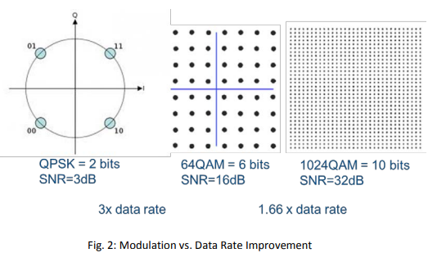
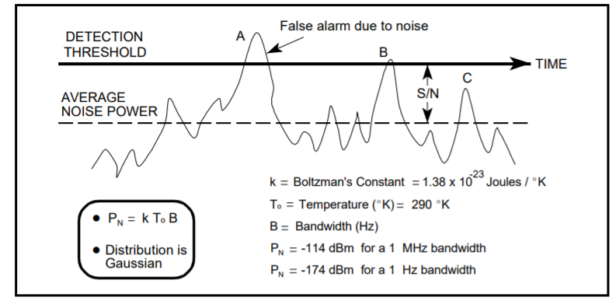
OFDM with higher modulation: performance
Flip side of higher modulation scheme is on sensitivity performance
NF
Sensitivity S = 10lg(kTB) + NF + SNR
= -174dBm/Hz + 73dBm(20MHz,BW)+5dB+3dB
=-93dBm
SNR(QPSK)
Sensitivity requirement for the receiver changes with error performance requirements., Say for example 5%/10 frames in error
Typical SNRs with higher modulation schemes
SNR

